Slide 1
Applied Physics Lecture #. 15
Author: Rizwan Fazal

Slide 2
Table of Contents
Centripetal & Centrifugal Forces
Equations of Motion
Equilibrium
Moment of Force
Electrostatic Force & Coulomb’s Law

Slide 3
Centripetal Force
Centripetal force is the force acting towards the center of the circular path.
If any moving object in a circular path is constantly changing its direction means it is constantly accelerating.
Using Newton’s second law of motion, if an object is travelling in a circular path, it is found that the centripetal force of an object moving in a circular path always acts towards the center of the circle.

Slide 4
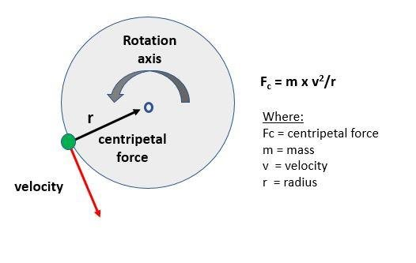
Centripetal Force

Slide 5
Calculating Centripetal Force
It is the product of mass (kg) and tangential velocity (m/s) squared, divided by the radius (meters), as given below;
F = ma_{c} = mv²/r
F → Centripetal Force
a_{c} → Centripetal Acceleration
m → mass of the object
v → speed or velocity of the object
r → radius

Slide 6
Centrifugal Force
Object moving in a circular path experiencing an outward force is called the centrifugal force.
This force depends on the mass of the object, the distance from the center of the circle and the speed of rotation.
If object has more mass, the force of movement and speed of object will be greater. Also, if distance is far from the center of the circle, the force of movement will be more.

Slide 7
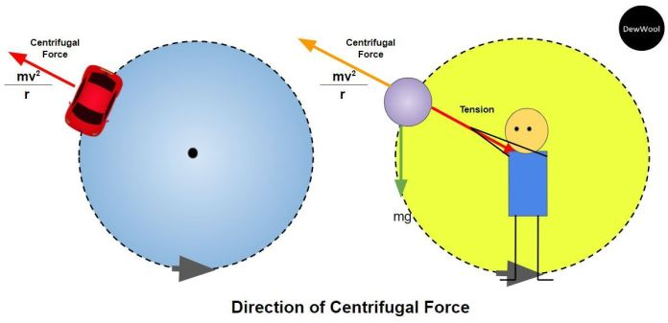
Centrifugal Force

Slide 8
Calculating Centrifugal Force
It is the product of mass (kg) and tangential velocity (m/s) squared, divided by the radius (meters), as given below;
F_{c} = - ma_{c} = - mv²/r
F_{c} → Centrifugal Force
m → mass of the object
v → speed or velocity of the object
r → radius

Slide 9
Equations of Motion
Motion is the state of change in position of an object over time.
It is described in terms of Displacement, Distance, Velocity, Acceleration, Time and Speed.
The relations between these quantities are known as the equations of motion.

Slide 10
Laws of Constant Acceleration
There are three equations of motion if there is a uniform acceleration.
They can only be applied when acceleration is constant and motion in a straight line.
These equations are used to derive the components like displacement, velocity (initial & final), time and acceleration.
v = u + at
v² = u² + 2as
s = ut +1/2(at²)

Slide 11
Equilibrium
An object is in equilibrium if the net force acting on that object is equal to zero.
An object that is not moving is in equilibrium, however an object in equilibrium is not necessarily at rest.
An object that is moving can also be in equilibrium provided that it maintains a constant velocity.
According to Newton’s 2nd law of motion:
Σ F = ma = 0 (meaning, a = 0)

Slide 12
Equilibrium
Static Equilibrium:
Where the object’s velocity is zero.
Dynamic Equilibrium:
Where the object is moving at a constant velocity. The forces in all directions are balanced.

Slide 13
Moment of Force
The moment of a force or torque, r, is defined as the turning effect of the force about a pivot.
It is the product of force (F) and the perpendicular distance (d) from the line of action of the force to the pivot.
The SI unit of moment of a force is Newton-meter and it is a vector quantity
Its direction is given by the right-hand grip rule perpendicular to the plane of the force and pivot point which is parallel to the axis of rotation

Slide 14
Moment of Force
Mathematically,
r = F x d
Where;
r = moment of force / torque
F = force
d = perpendicular distance from the line of action of the force to the pivot

Slide 15
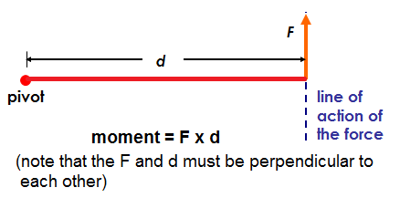
Moment of Force

Slide 16
Electrostatic Force
Electrostatic force or Coulomb force is the force of attraction or repulsion between particles or objects due to their electric charge.
Two like electric charges, both positive or negative, repel each other along a straight line between their centers.
Two unlike charges, one positive and another one negative, attracts each other along a straight line joining their centers.

Slide 17
Coulomb’s Law
The Coulomb’s law states that;
The magnitude of the electric force F is directly proportional to the amount of one charge, q₁, multiplied by the other charge, q₂, and inversely proportional to the square of the distance ‘r’ between their centers.
Mathematically, we can express the above law as;
F = k q₁q₂/r² (k is Coulomb’s constant)

Slide 18
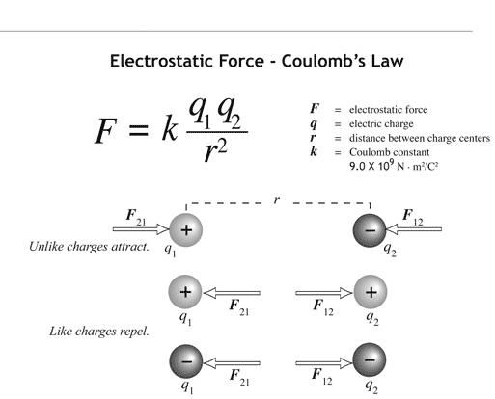
Coulomb’s Law

